Slide 1
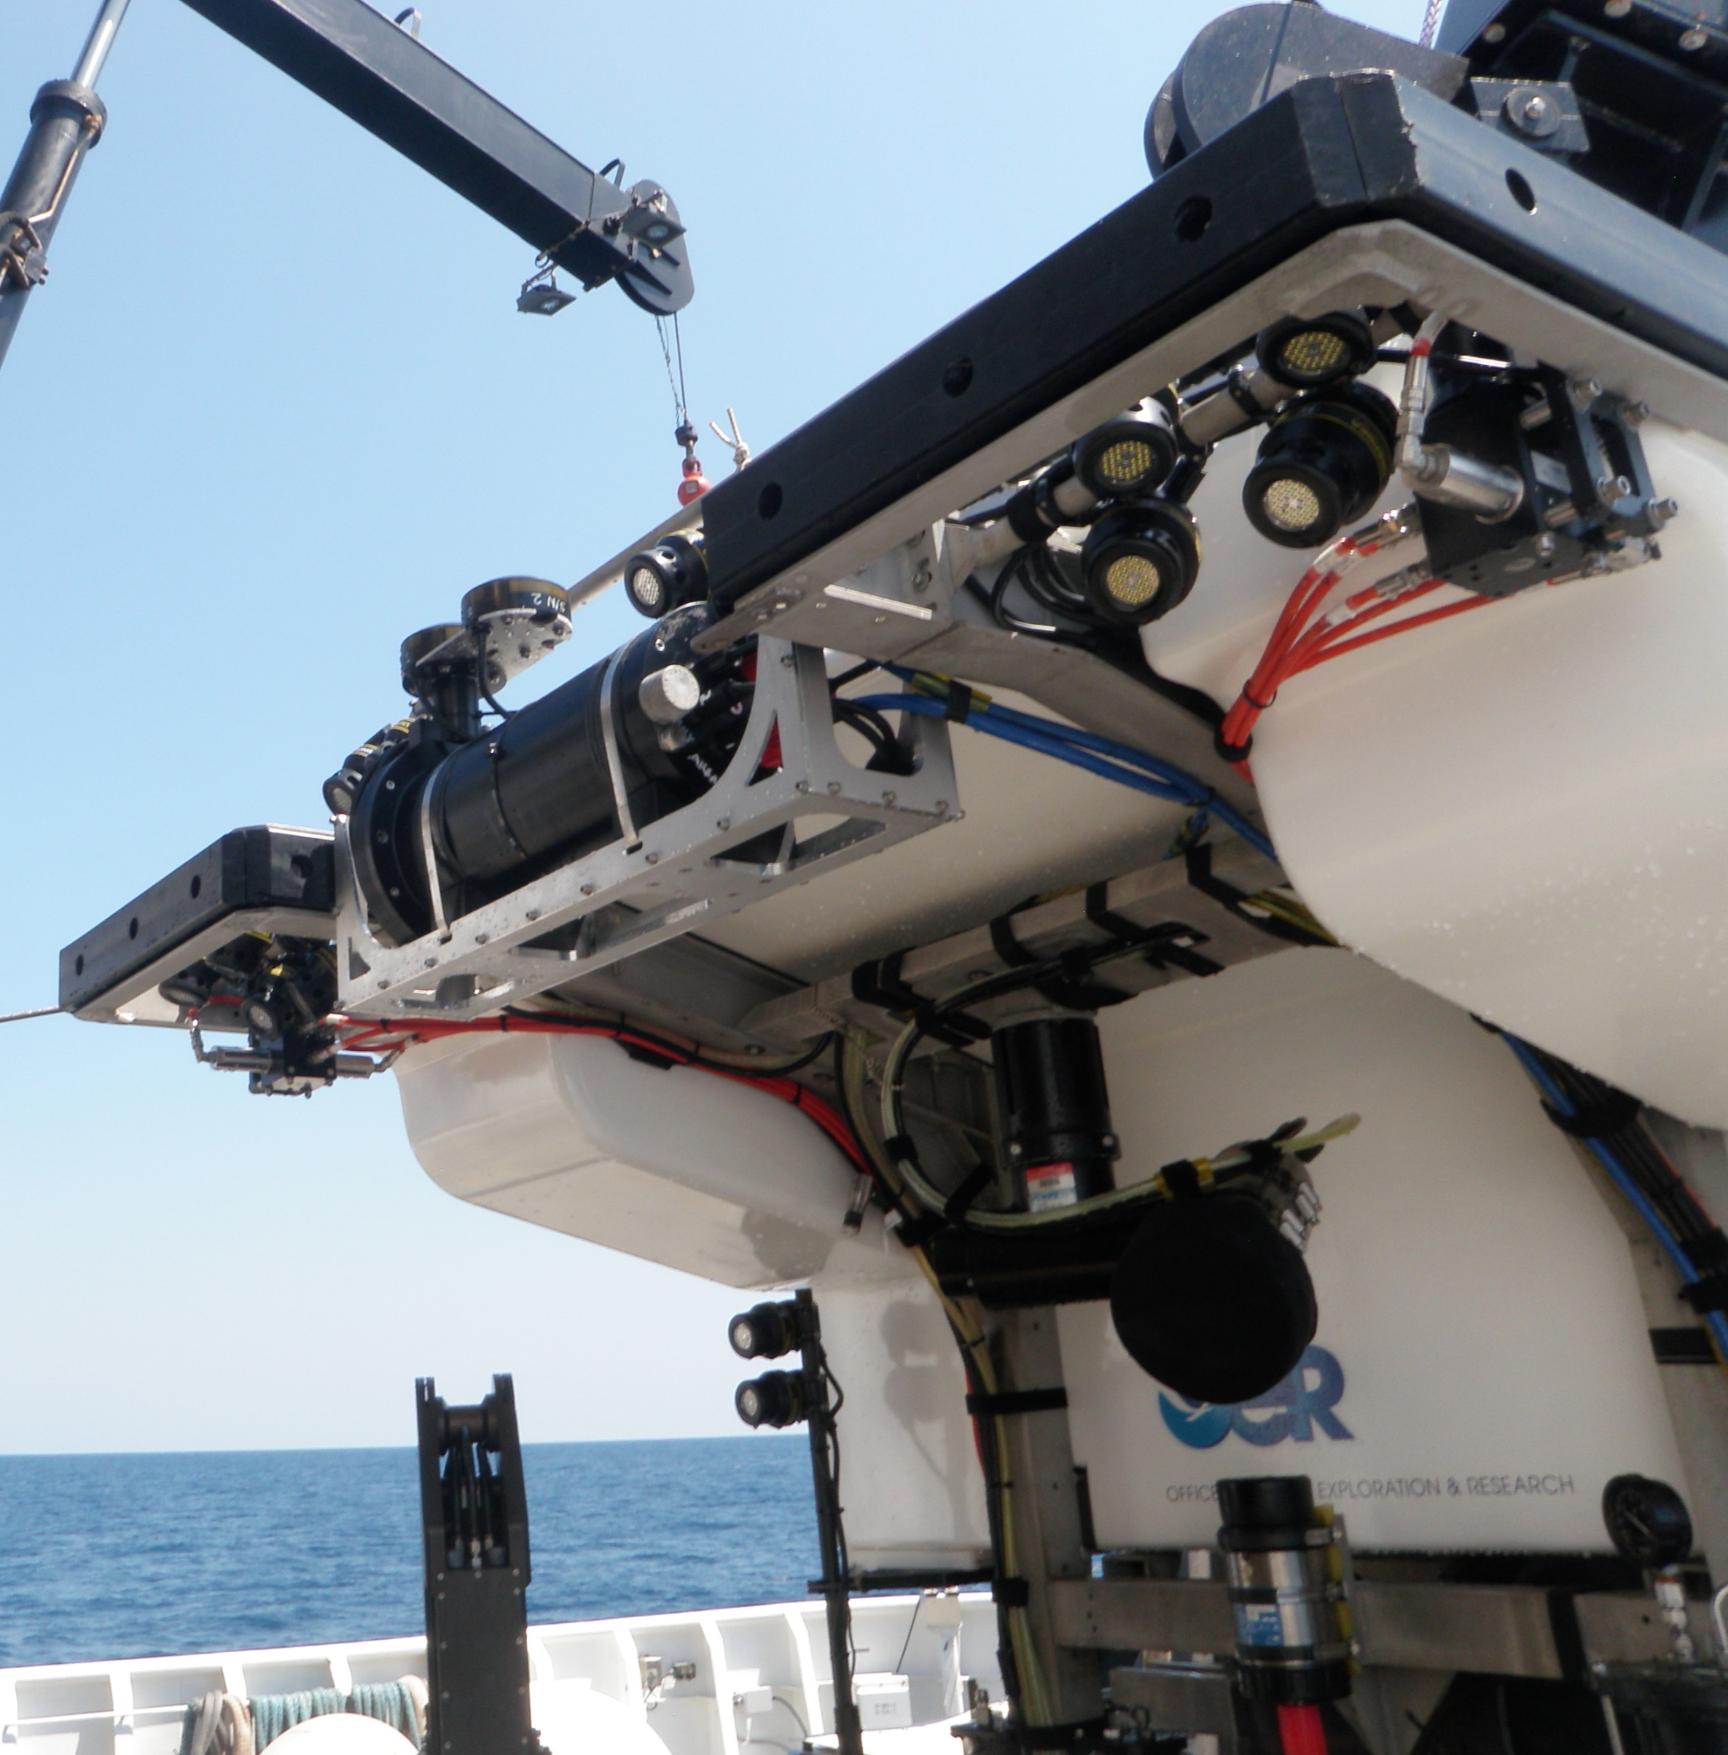
EX1904
Objectives
Record raw acoustic time series data
Provide a baseline for comparison to WHOI micromodem processed data
Development of beamforming for independent angle and range calculations
Determine viability of hardware for multichannel, high frequency recording

Slide 2
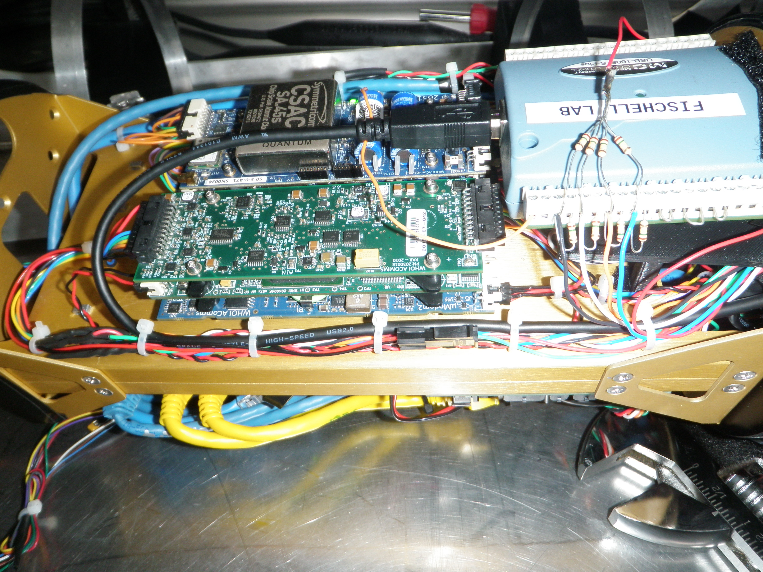
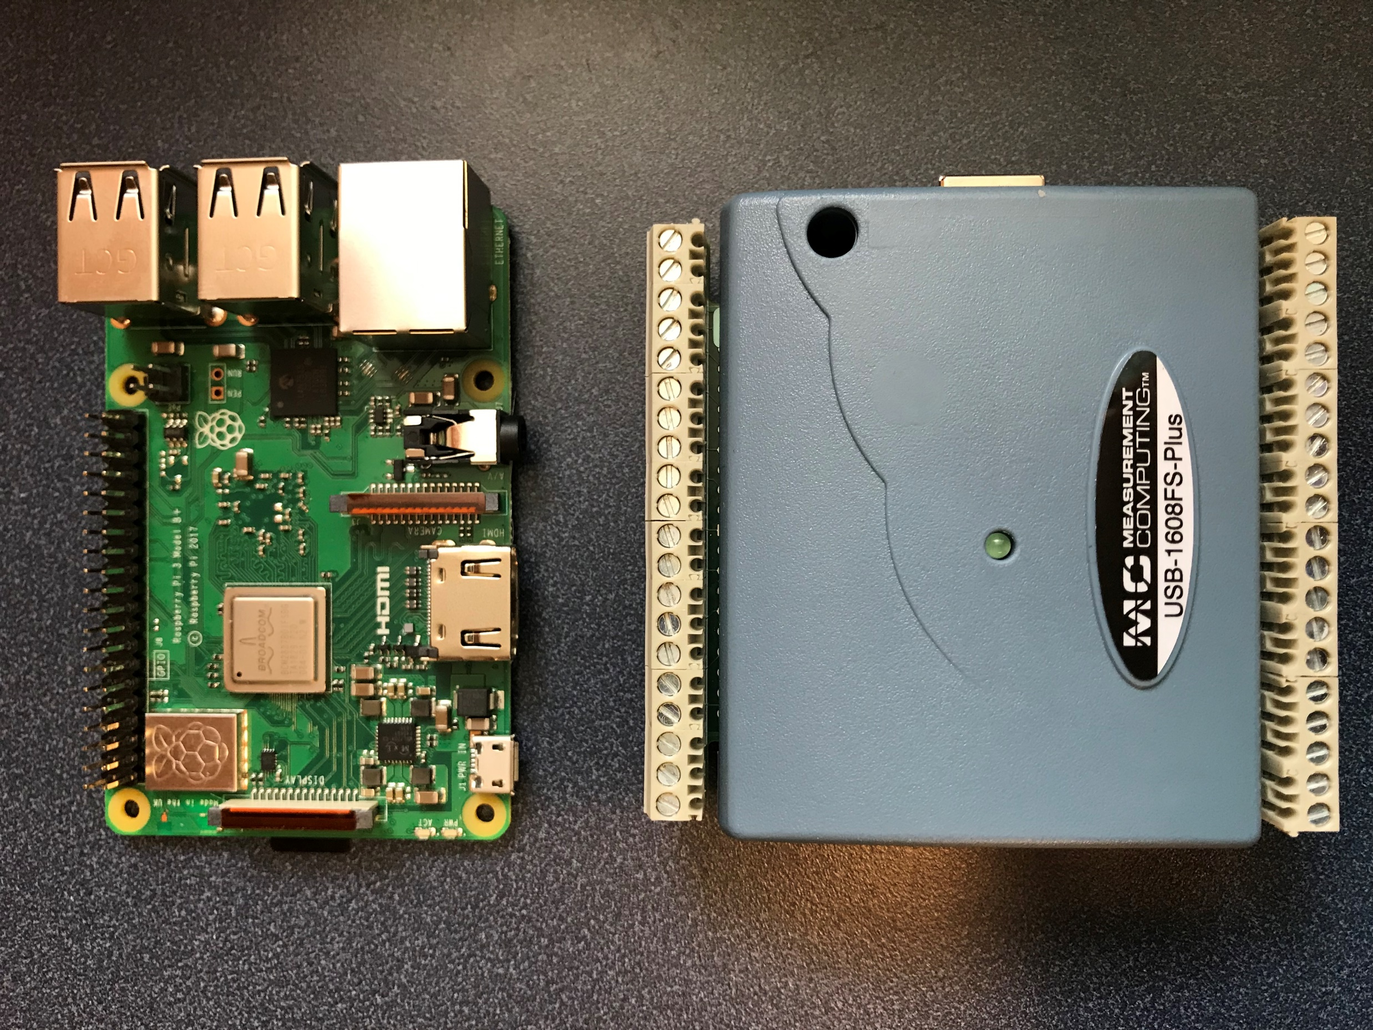
EX1904
Test Configuration
Raspberry Pi Model 3B+
5V power from distribution board
Ethernet
USB to DAQ
SSH enabled
MCC USB-1608-FS-Plus DAQ
Four hydrophone channels and PPS
100K samples/channel/second max
400K samples/second aggregate max
Python based software developed from manufacturer’s library

Slide 3
EX1904
Observations
Raspberry Pi 3B+ presented a hardware bottleneck which limited maximum recording rate
Raspberry Pi 3B+ does not have a real time clock and requires an NTP server
Array circuitry includes a pre-amp, necessitating bias resistors
Recordings
First two days of recording were affected by the lack of DC bias control
Third day successful
2 hours of recording 5 channels at 45K samples/channel/second
2 hours of recording Channels 1-3 at 70K samples/channel/second

Slide 4
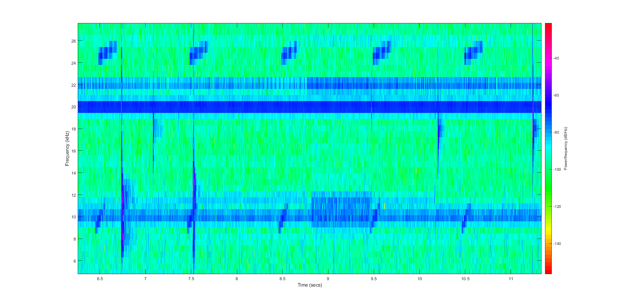
25 kHz
iUSBL
Ship’s USBL
10 kHz
iUSBL
ROV response

